Slide 1

Data Analyst Professional Level 01
Hands on Activity
Asad Masood Qazi
Sr. Software Engineer (Data Analytics),
SYSTEMS Ltd,
Email: asadmasood1@Hotmail.com ;

Slide 2
About Me
Working as Sr. Software Engineer – Data Analytics @ Systems Limited
Qualification: BS(IT) & MS(CS)
Professional Work Experience: 5 plus years in Business Intelligence and Data Analytics Domain
Professional Trainer

Slide 3
Contents
Introduction to Data Analytics
Data Revolution and Data Literacy Culture
Applications of Data Analytics in Digital World.
Roles and Responsibilities as Data Analyst
conclusion
SLIDE - 3

Slide 4
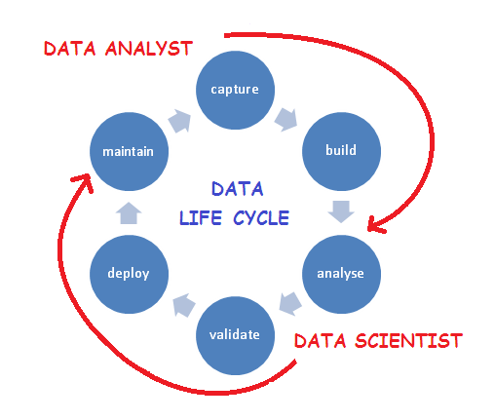
Data Analyst Life Cycle

Slide 5
Data
August 2019
Samsung Note 10
1,40,000 PKR
Asad
Islamabad
----------------------------
Information
Intelligence
Analytics/
Prediction

Slide 6
Data
Asad Bought Samsung Galaxy Note 10 for 1,40,000 PKR at Islamabad.
----------------------------
Information
Intelligence
Analytics/
Prediction

Slide 7
Data
Let’s Say Price was 1,00,000
So its on Profit
----------------------------
Information
Intelligence
Analytics/
Prediction

Slide 8
Data
Predict future sales on this particular product Samsung Galaxy Note 10
----------------------------
Information
Intelligence
Analytics/
Prediction

Slide 9
Data Literacy <–> Data = Understanding
Give Value to Data <-> Value = Profit
Increase Revenue ----- Decrease Cost
Ability to Read, Work with, Analyze and Argue with Data
People: Data Literacy
Process: Key Areas to Drive Data Driven Decisions
Platform: End to End Data Platform

Slide 10
Data Revolution in Digital Era
In digital era we are either producing or consuming data
More than 3.7 billion humans use the internet (that’s a growth rate of 7.5 percent over 2016).
On average, Google now processes more than 40,000 searches EVERY second (3.5 billion searches per day)!
“Data is the new oil.” — Clive Humby
New York Stock Exchange TOP: Apple, google, Microsoft, amazon….

Slide 11
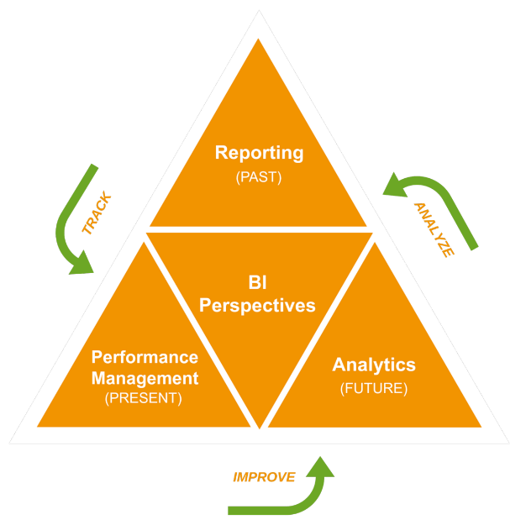
The Data Perspectives
PAST: What Happened?
Reactive reporting
Common among most companies
PRESENT: What is Happening?
KPI’s and CPM Concepts
Streaming analytics
FUTURE: What will Happen?
Predict based on trends and external data
Understand impact and what-if analysis

Slide 12
Some Case Studies
Cambridge Analytica interference in Presidential Election in USA with the collaboration of Facebook to manipulate the voting decision of public.
Facebook #10YearsChallenge is also an example of making decisions with the help of existing or available data
Marketing Campaigns (In Pricing, offers and so on)
All Sectors like Healthcare, Retail, Sports, Entertainment etc.

Slide 13
Few Movies.. !
deus ex machina,” translated as “god from the machine
Minority Report
Money Ball

Slide 14

What’s Going On ?

Slide 15




Thank You!
https://pk.linkedin.com/in/asadmasoodqazi
/AsadMasoodQazi
@asadmasoodqazi
@asadmasoodqazi

